Slide 1

Mathematics of Data II Diffusion Geometry
姚 远
北京大学数学科学学院
2011.7.12

Slide 2
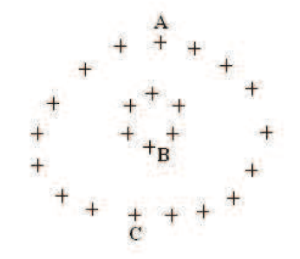
Data Distances
We look for distance function such that
dist(A,C) is small
dist(A,B) is large
Geodesic distance is one candidate, but hard to compute and sensitive to noise
Any other distance with such properties but robust to stochastic noise?

Slide 3
Data Graph
Given n points x_{i}, i=1,…,n, as vertices in V
Similarity weight between x_{i} and x_{j} is w_{ij}=w_{ji}, e.g.
Undirected weighted graph G(V,E,W), W=(w_{ij})

Slide 4
Random Walk on Graphs
Degree d_{i} = Σ_{k} w_{ik}, D = diag(d_{i})
Random walk on G(V,E,W)
Transition probability P = D⁻¹ W where p_{ij} = w_{ij}/d_{i}
Stationary distribution π_{i} ~ d_{i}
Irreducible (G is connected)
Reversible w_{ij} = w_{ji} π_{i} p_{ij} = π_{j} p_{ji}

Slide 5
Symmetric Kernel
P = D⁻¹W is similar to S = D^{-1/2}WD^{-1/2}, as P = D^{-1/2}SD^{1/2}
S is real symmetric, whence eigen-decomposition

Slide 6
Spectrum of P
Eigenvalues of S and P are the same, so
Φ and Ψ are right and left eigenvector matrix of P, respectively, Φ^{T}Ψ = V^{T}V = I
In particular, P 1 = 1, whence

Slide 7
Diffusion Map
Let λ_{i} be sorted by
Diffusion map of x_{i} is defined via right eigenvectors

Slide 8
Dimensionality Reduction
λ₁ = 1 and φ₁= 1, so it does not distinguish points
Threshold by δ, for those
Define

Slide 9
Diffusion Distance
Define the diffusion distance between points at scale t
This is exactly the weighted 2-distance between diffusion profiles

Slide 10
Lumpability of Markov Chains
Let P be the transition matrix of a Markov chain defined on n states S={1,…,n}.
Γ={S₁,…,S_{k}} is a partition of S into k macrostates.
Sequences {x₀,…,x_{t},…} generated by P, i.e.
Prob(x_{t}=j ; x_{t-1}=i)= P_{ij}
Induced dynamics: relabel x_{t} by y_{t} from corresponding states in partition Γ
[Kemeny-Snell’76] P is called lumpable if
Prob(y_{t}=k₀; y_{t-1}=k₁, …,y_{t-m}=k_{m}) = Prob(y_{t}=k₀; y_{t-1}=k₁)
i.e. the induced dynamics is Markovian.
Notes:
A popular approach is to first cluster all the conformations into a large number of small sets of very structurally similar, and therefore likely kinetically similar, conformations called microstates. We then used spectral clustering lump microstates that can interconvert rapidly into larger states called metastable states while conformations separated by large free energy barriers are grouped into different states
10

Slide 11
A Necessary and Sufficient Condition for Lumpability
[Kemeny-Snell’76] P is lumpable w.r.t. partition Γ={S₁,…,S_{k}} iff for any s, t chosen from P, and for any i, j lying in S_{a}, the following holds
P_{ib}= P_{jb}
where
P_{ib}
P_{jb}
S_{b}
S_{a}
Notes:
A popular approach is to first cluster all the conformations into a large number of small sets of very structurally similar, and therefore likely kinetically similar, conformations called microstates. We then used spectral clustering lump microstates that can interconvert rapidly into larger states called metastable states while conformations separated by large free energy barriers are grouped into different states
11

Slide 12
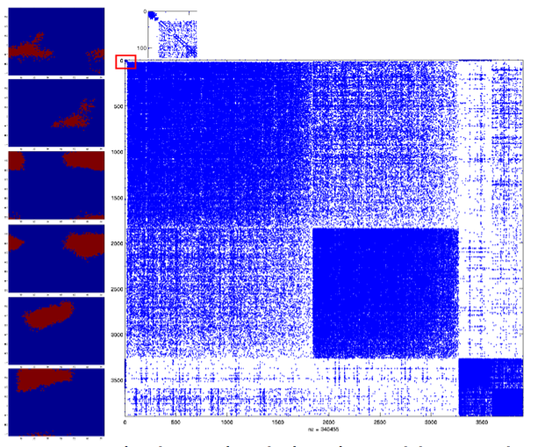
Spectral Theory of Lumpability
[Meila-Shi 2001] P is lumpable w.r.t. P iff P has k independent piece-wise constant right eigenvectors in the span of characteristic functions of Γ={S₁,…,S_{k}}.
Special case: If P is block diagonal, i.e. uncoupled Markov chain, then P is lumpable with piece-wise constant right eigenvectors associated with multiple eigenvalue 1.
[e.g. Belkin-Shi-Yu 2007] If P is nearly block diagonal, then there are top-k eigenvectors which fix signs within the block.
Notes:
A popular approach is to first cluster all the conformations into a large number of small sets of very structurally similar, and therefore likely kinetically similar, conformations called microstates. We then used spectral clustering lump microstates that can interconvert rapidly into larger states called metastable states while conformations separated by large free energy barriers are grouped into different states
12

Slide 13
Example I
1
1/2
1/2
Consider 2n nodes on a linear chain
Markov Chain: a node will jump to its neighbors with equal probability
P(i, i-1) = P(i, i+1) = ½, for 2n>i>1
P(1,2) = P(2n,2n-1) = 1

Slide 14
Example I
1
1/2
1/2
P is lumpable w.r.t. Γ*=(S_{even},S_{odd})
S_{even}: even nodes
S_{odd}: odd nodes
Γ* corresponds to eigenvector with eigenvalue -1

Slide 15
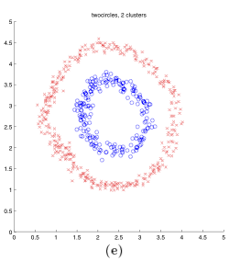
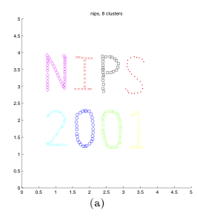
Spectral Clustering Algorithm
Typical spectral algorithm to find lumpable states in nearly uncoupled systems [Ng-Jordan-Weiss NIPS’01]:
Find top k right eigenvectors of P where a large spectral gap occurs, v₁,…,v_{k}
Embed the data into R^{k} by those eigenvectors
Use k-means (or alternatives) to find k clusters in R^{k}
Notes:
A popular approach is to first cluster all the conformations into a large number of small sets of very structurally similar, and therefore likely kinetically similar, conformations called microstates. We then used spectral clustering lump microstates that can interconvert rapidly into larger states called metastable states while conformations separated by large free energy barriers are grouped into different states
15

Slide 16
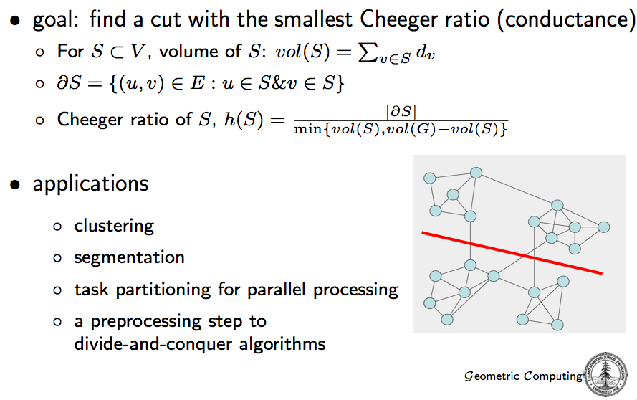
Graph Partition Problem

Slide 17
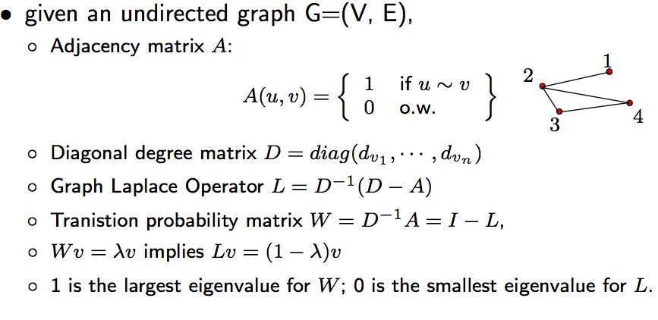
Graph Laplacian Operator

Slide 18
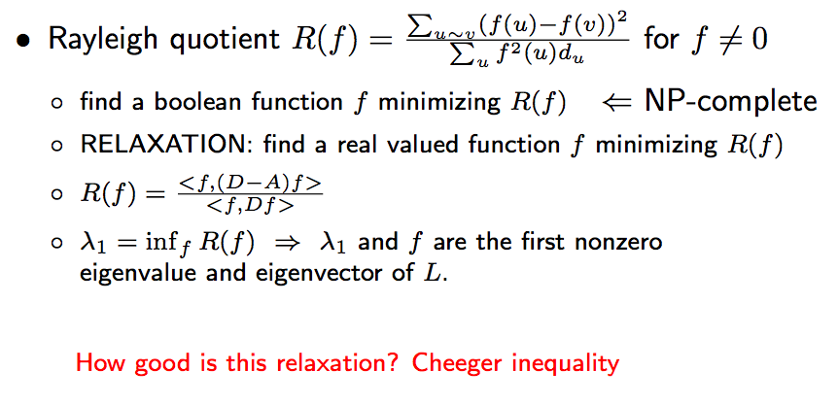
Graph Partition Problem

Slide 19
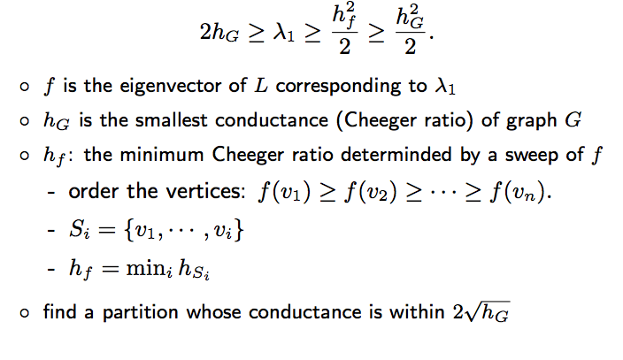
Cheeger Inequality

Slide 20
Example I
1
1/2
1/2
One graph min-cut given by second largest right eigenvector of T
n=8,
v₂=[0.4714 0.4247 0.2939 0.1049 -0.1049 -0.2939 -0.4247 -0.4714]
Eigenvalue is 0.9010

Slide 21
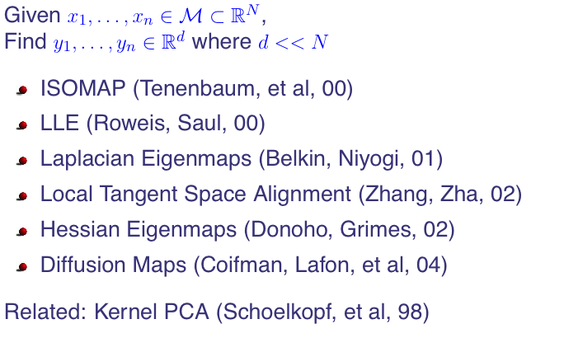
Connections to Manifold Learning

Slide 22
All you wanna know about differential geometry but were afraid to ask, in 9 easy slides

Slide 23
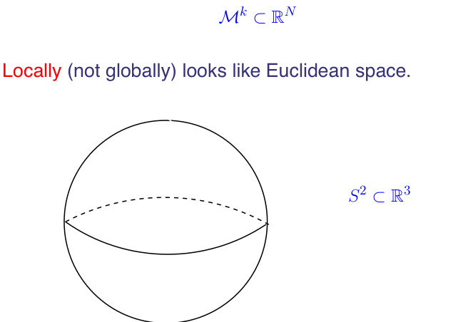
Embeded Manifolds

Slide 24
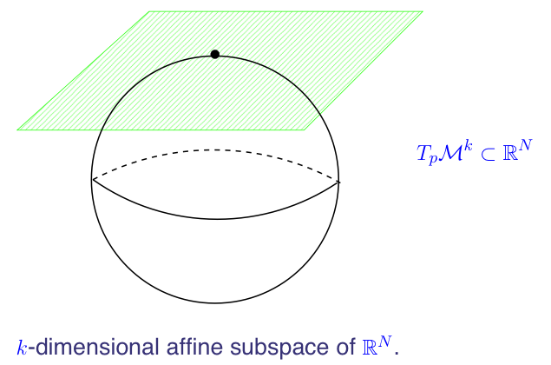
Tangent Space

Slide 25
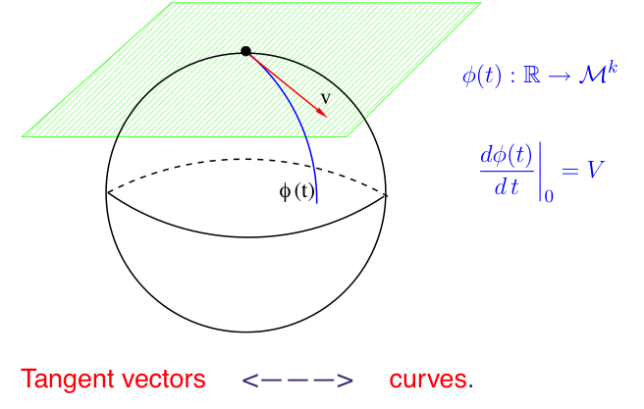
Tangent Vectors and Curves

Slide 26
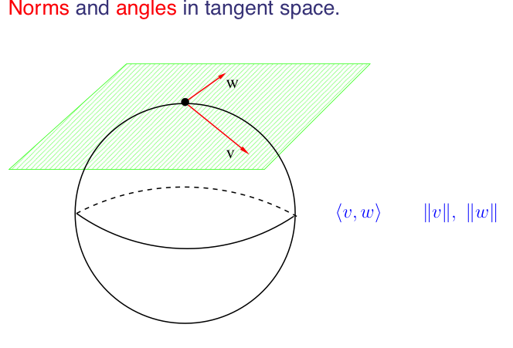
Riemannian Geometry

Slide 27
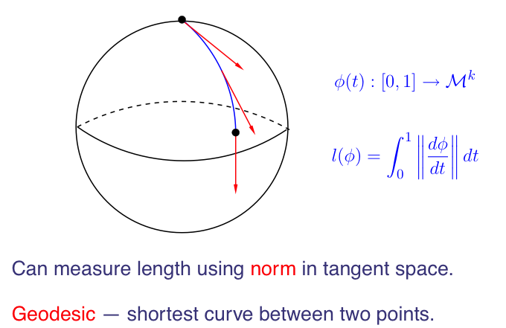
Geodesics

Slide 28
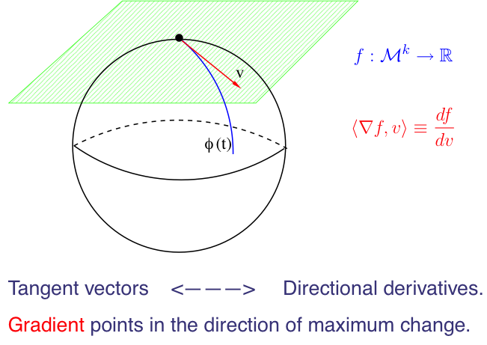
Gradients

Slide 29
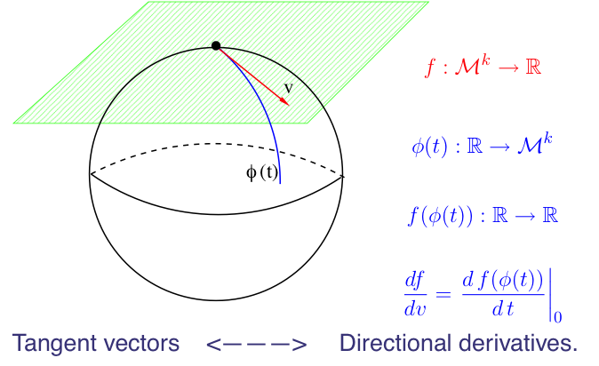
Tangent Vectors vs. Derivatives

Slide 30
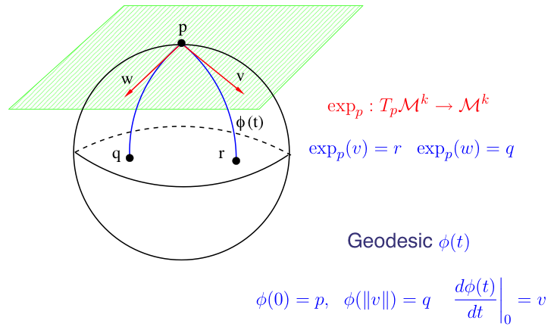
Exponential Maps

Slide 31
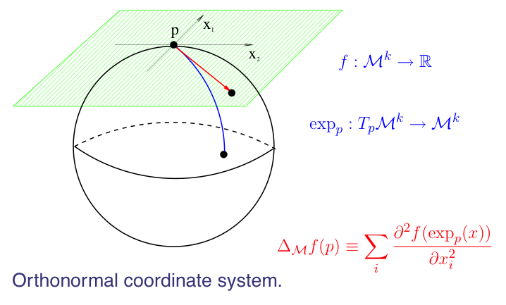
Laplacian-Beltrami Operator

Slide 32
Meta-Algorithm
Construct a neighborhood graph
Construct a positive semi-definite kernel
Find the eigen-decomposition
Kernel
Spectrum

Slide 33
Recall: MDS
Idea: Distances -> Inner Products -> Embedding
Inner Product:
K is positive semi-definite with

Slide 34
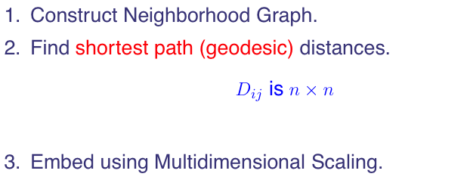
Recall: ISOMAP

Slide 35
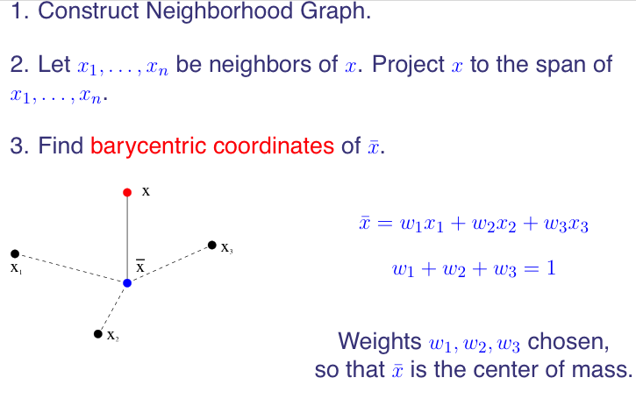
Recall: LLE (I)

Slide 36
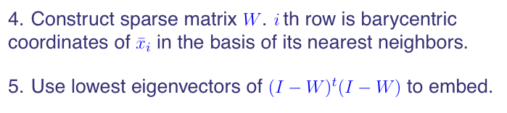
Recall: LLE (II)

Slide 37
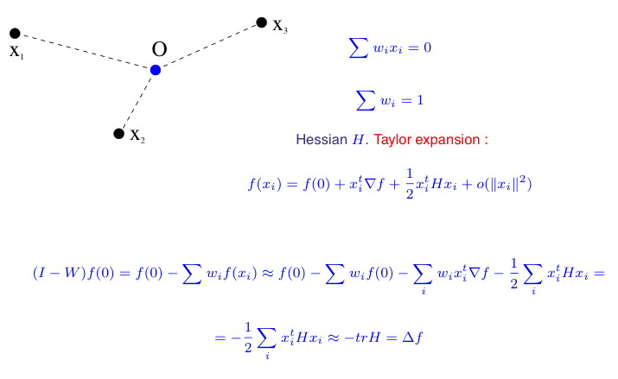
Laplacian and LLE

Slide 38
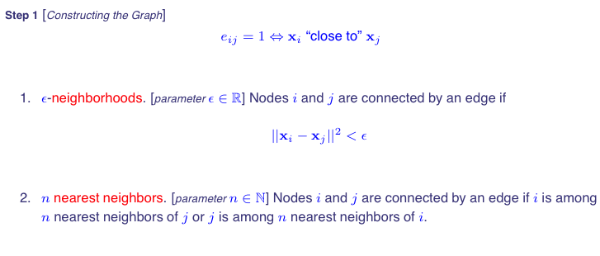
Laplacian Eigenmaps (I) [Belkin-Niyogi]

Slide 39
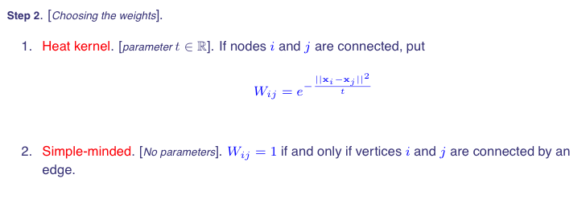
Laplacian Eigenmaps (II)

Slide 40
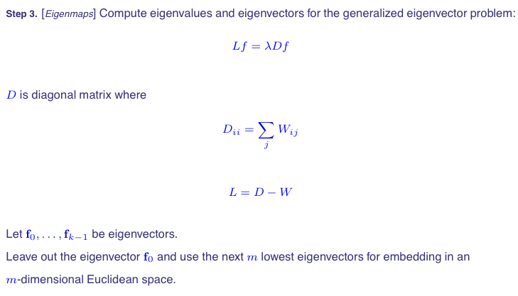
Laplacian Eigenmaps (III)

Slide 41
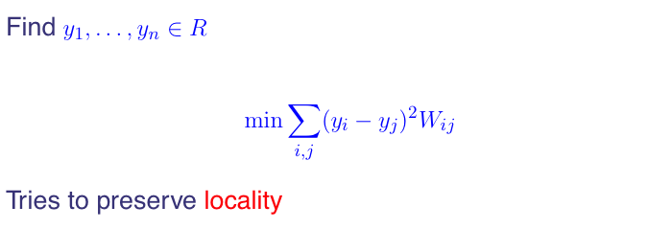
Justification

Slide 42
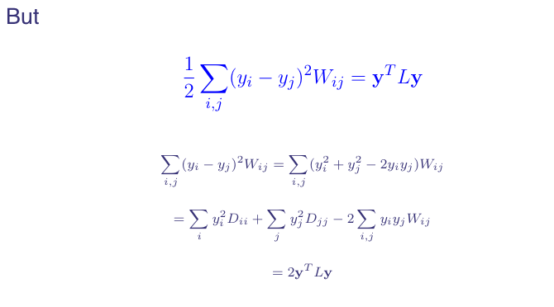
A Fundamental Identity

Slide 43
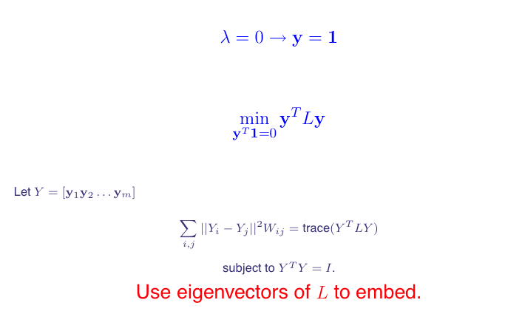
Embedding as Eigenmaps

Slide 44
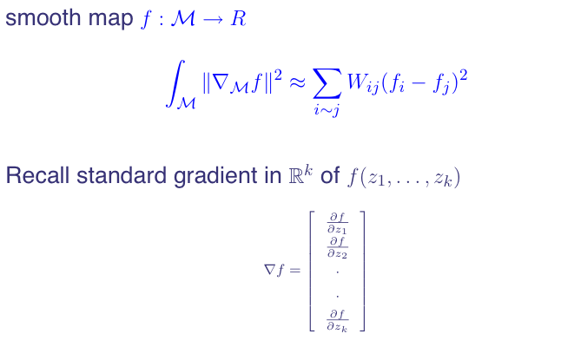
On the Manifold

Slide 45
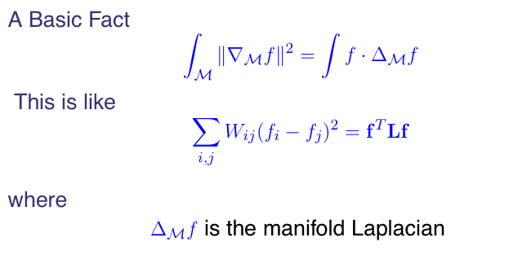
Stokes Theorem

Slide 46
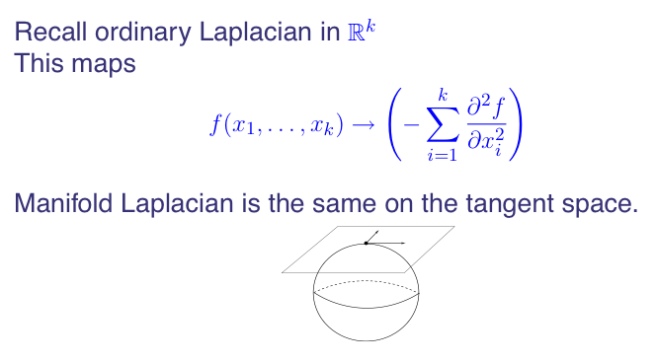
Manifold Laplacian

Slide 47
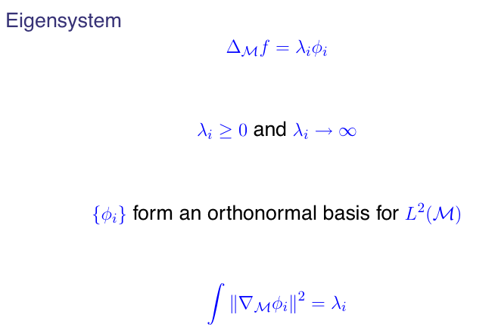
Manifold Laplacian Eigenvectors
Manifold Laplacian is non-compact!

Slide 48
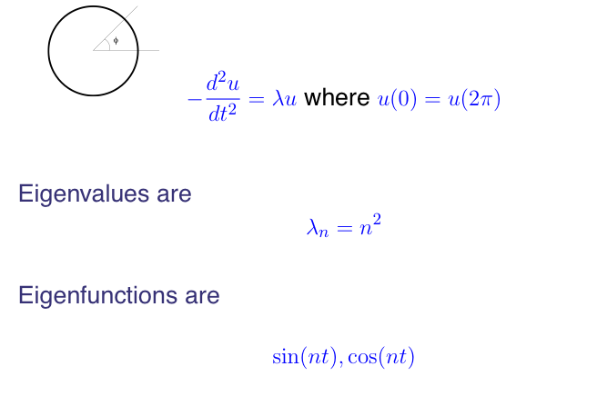
Example: Circle
Spherical Harmonics in high-D sphere!

Slide 49
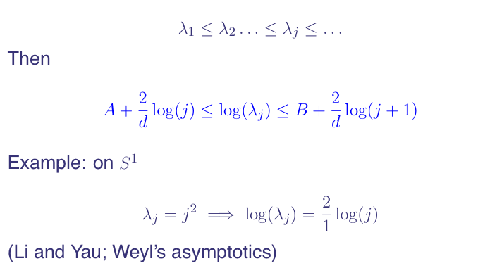
Spectral Growth

Slide 50
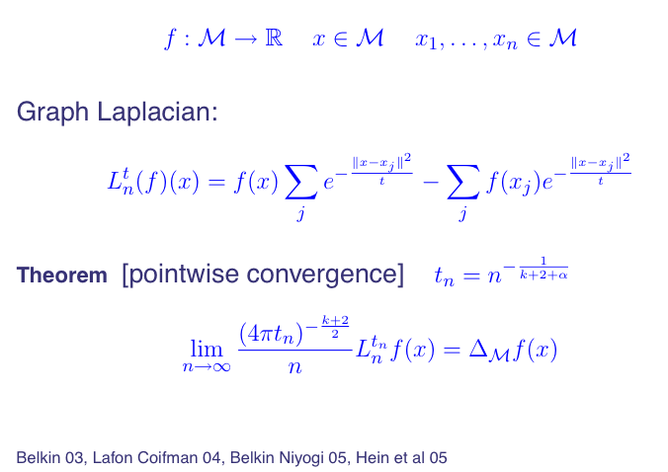
From Graph to Manifolds

Slide 51
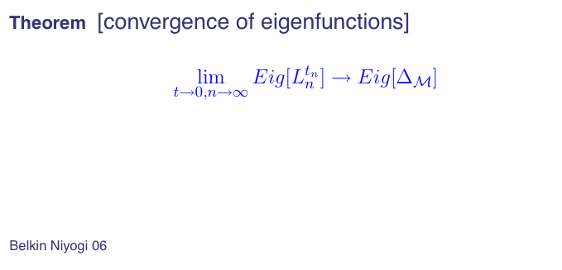
From Graph to Manifolds

Slide 52
Heat Diffusion Map
Gaussian kernel
Normalize kernel
Renormalized kernel
α=1, Laplacian-Beltrami operator, separate geometry from density
α=0, classical normalized graph Laplacian
α=1/2, backward Fokkar-Planck operator
Coifman-Lafon 2006. Diffusion Maps.

Slide 53
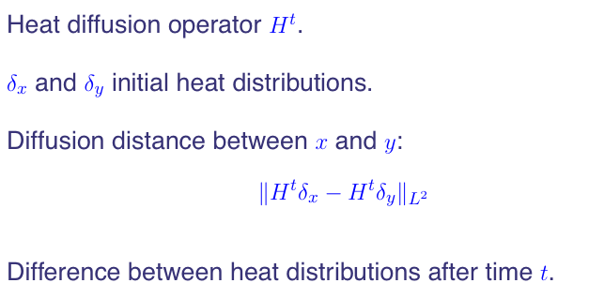
Heat Diffusion Distance

Slide 54
Note: Another choice of eigenmaps
Normalized positive semi-definite Laplacian
ϕ_{i} is an eigenvector of L_{n} with eigenvalue λ_{i}
Normalized Laplacian eigenmaps:

Slide 55
Connections to Markov Chain
L = D-W: unnormalized graph Laplacian
L_{n}=D^{-1/2} L D^{-1/2}: normalized graph Laplacian
P = I - D⁻¹L = D⁻¹W is the markov matrix
v is generalized eigenvector of L: L v = λ D v
v is also a right eigenvector of P with eigenvalue 1-λ
D^{1/2} v is eigenvectors of L_{n} with eigenvalue λ
P is lumpable iff v is piece-wise constant
So v is the most often choice of Laplacian eigenmaps and Diffusion Map

Slide 56
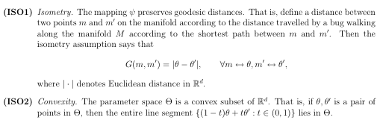
Two Assumptions on ISOMAP
Convexity is hard to meet: consider two balls in an image which never
intersect, whose center coordinate space (x₁,y₁,x₂,y₂) must have a hole.

Slide 57
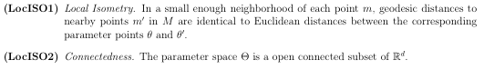
Relaxations (Donoho-Grimes’2003)

Slide 58
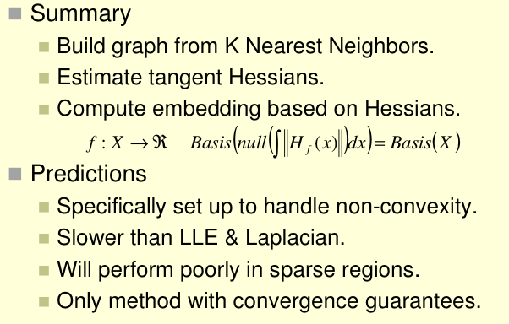
Hessian LLE
α
Note that:

Slide 59
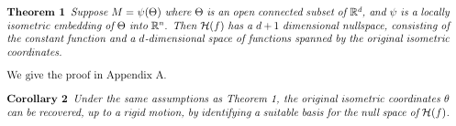
Convergence of Hessian LLE (Donoho-Grimes)

Slide 60
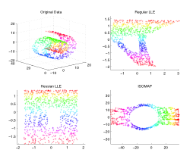
Comparisons on Swiss Roll with holes
α

Slide 61
Comparisons of Manifold Learning Techniques
MDS
PCA
ISOMAP
LLE
Hessian LLE
Laplacian LLE
Diffusion Map
Local Tangent Space Alignment
Matlab codes: mani.m
Courtesy of Todd Wittman

Slide 62
Reference
Tenenbaum, de Silva, and Langford, A Global Geometric Framework for Nonlinear Dimensionality Reduction. Science 290:2319-2323, 22 Dec. 2000.
Roweis and Saul, Nonlinear Dimensionality Reduction by Locally Linear Embedding. Science 290:2323-2326, 22 Dec. 2000.
M. Belkin and P. Niyogi. Laplacian eigenmaps for dimensionality reduction and data representation. Neural Computation, 15:1373–1396, 2003.
D. L. Donoho and C. Grimes. Hessian eigenmaps: New locally linear embedding techniques for high-dimensional data. PNAS 100 (10): 5591–5596 2003.
R. R. Coifman, S. Lafon, A. B. Lee, M. Maggioni, B. Nadler, F. Warner, and S. W. Zucker. Geometric diffusions as a tool for harmonic analysis and structure definition of data: Diffusion maps. PNAS 102 (21):7426-7431, 2005.
M. Hein, J.-Y. Audibert, and U. von Luxburg. From graphs to manifolds - weak and strong pointwise consistency of graph Laplacians. In P. Auer and R. Meir, editors, Proc. of the 18th Conf. on Learning Theory (COLT), pages 486–500, Berlin, 2005. Springer.
Ulrike von Luxburg, Mikhail Belkin, and Olivier Bousquet. Consistency of spectral clustering. Ann. Statist. Volume 36, Number 2 (2008), 555-586.

